Slide 1
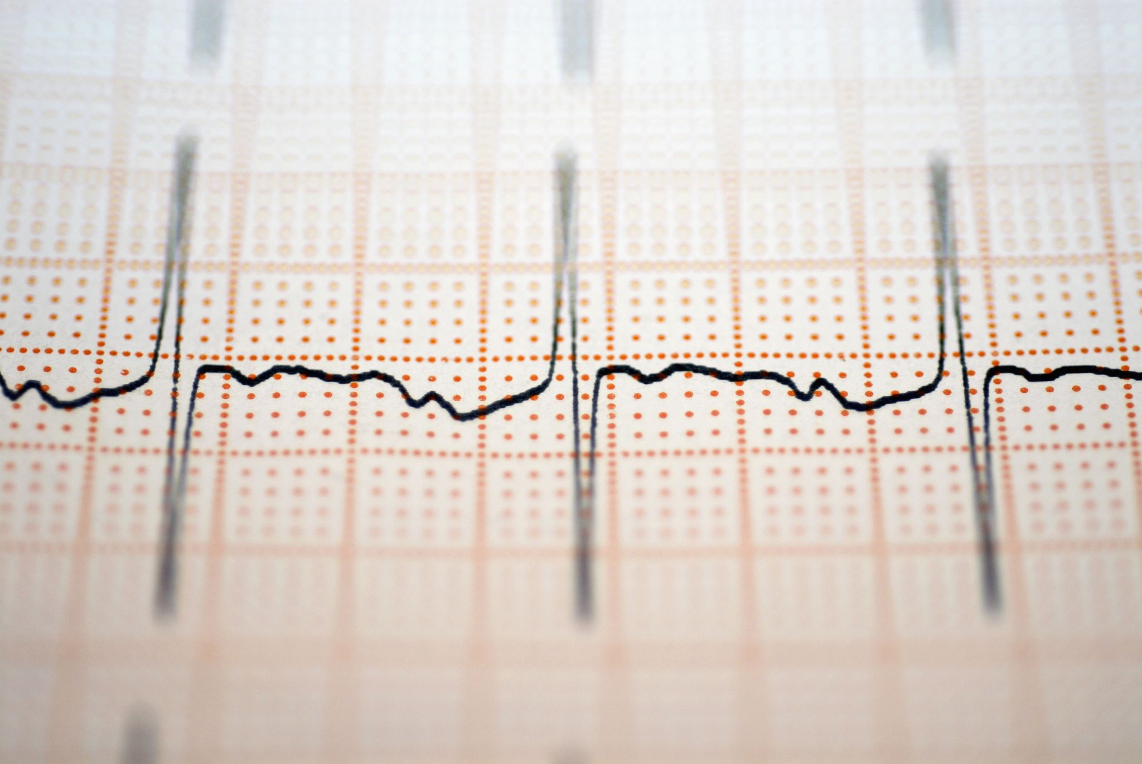
Pulse Width Modulation Using ( Graphical LCD and ATmega32 ) Amit Graduation Project
Introduced by: George Emad Shoukry
Group D33

Slide 2
OverView
-PWM drawer works as a mini oscilloscope that is responsible for printing the frequency and the waveform of the generated PWM signal.
-(PWM) is a modulation technique that generates variable-width pulses to represent the amplitude of an analog input signal. The output switching transistor is on more of the time for a high-amplitude signal and off more of the time for a low-amplitude signal.

Slide 3
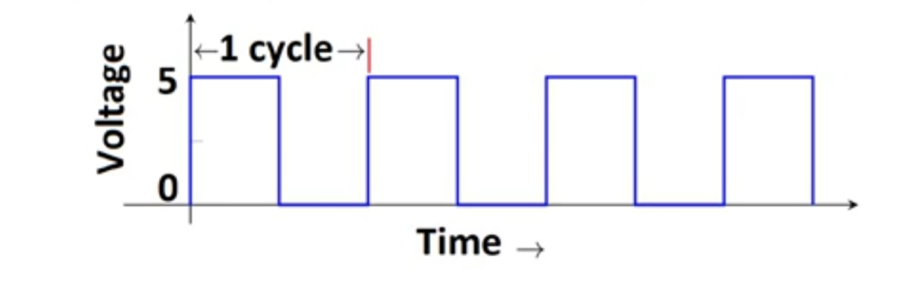
- period of a pulse consists of an ON cycle (5V) and an OFF cycle (0V). The fraction for which the signal is ON over a period is known as the duty cycle.
Frequency signals, or other waves, expresses the number of cycles of the repetitive waveform per second.
Duty Cycle (In %) = Ton /total period *100

Slide 4
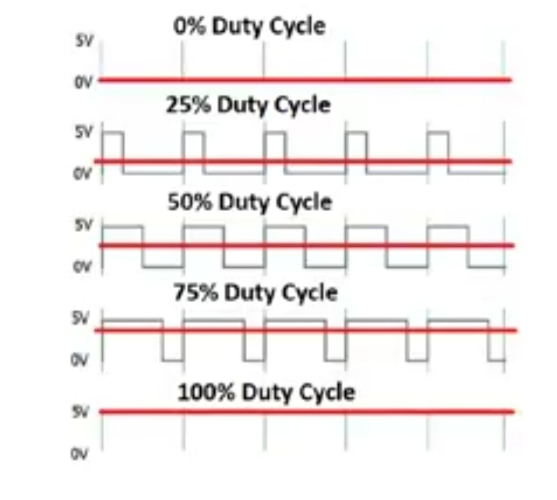

Slide 5
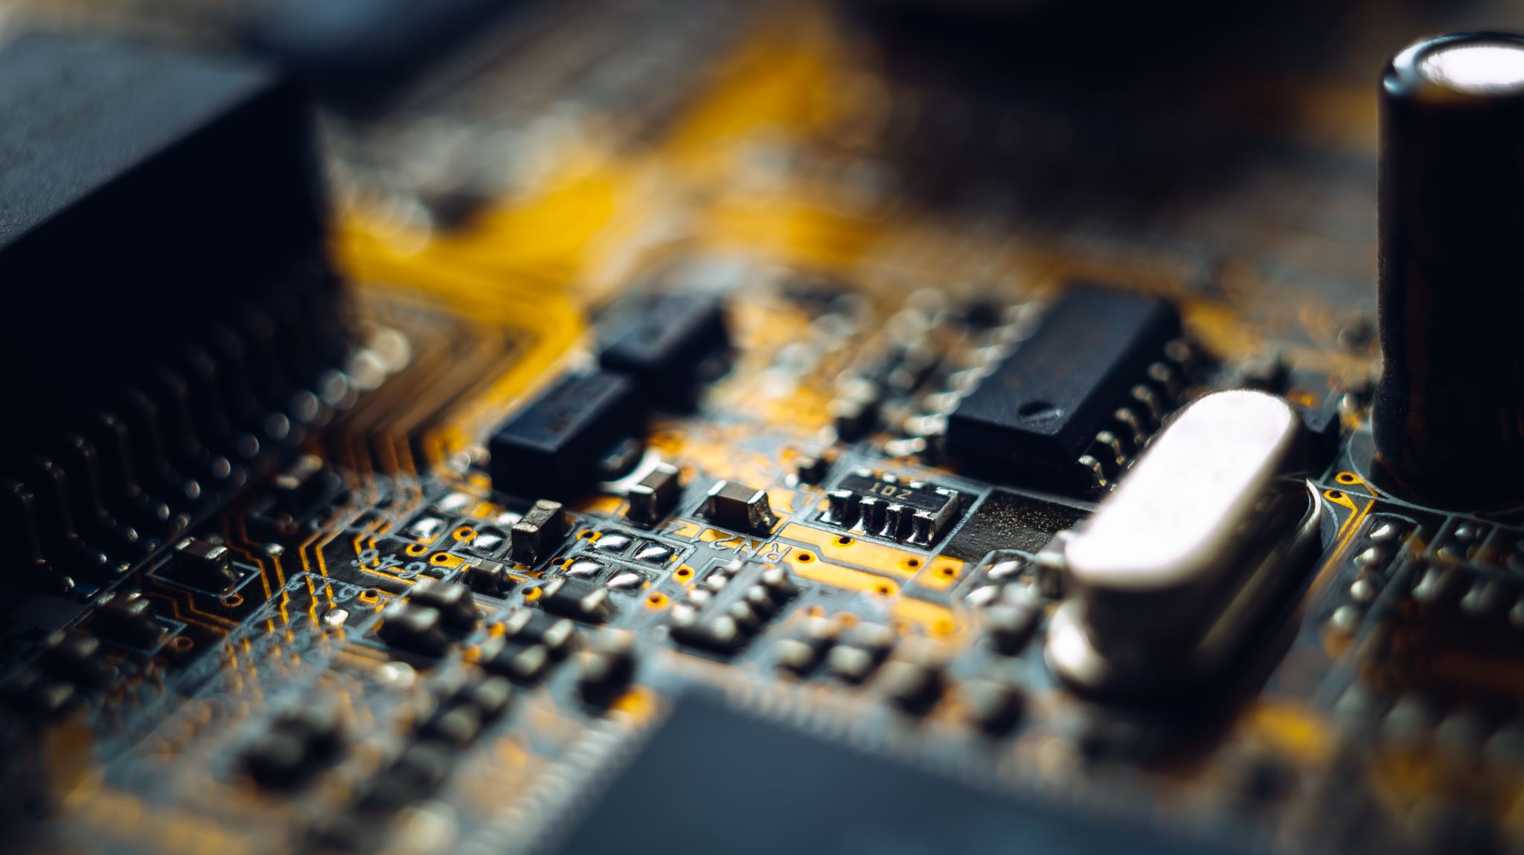
-Finally, we can use PWM in many applications, ranging from communications to power control and conversion -For example, the PWM is commonly used to control the speed of electric motors, the brightness of lights, ultrasonic cleaning applications, and many more.

Slide 6
Layered Architicture
Application Layer
PWM DRAWER
Hardware Abstraction Layer
G-LCD
Micro-Controller Abstraction Layer
DIO
GPT
PWM
ICU

Slide 7
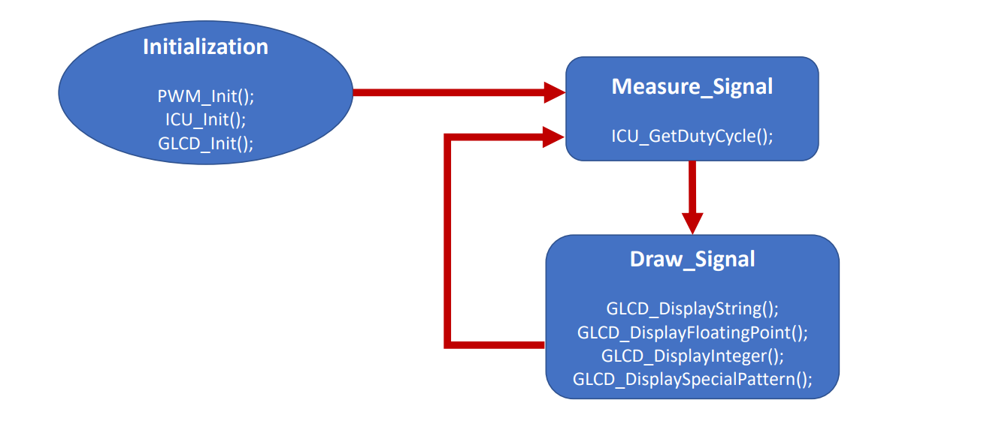
Flow Chart

Slide 8
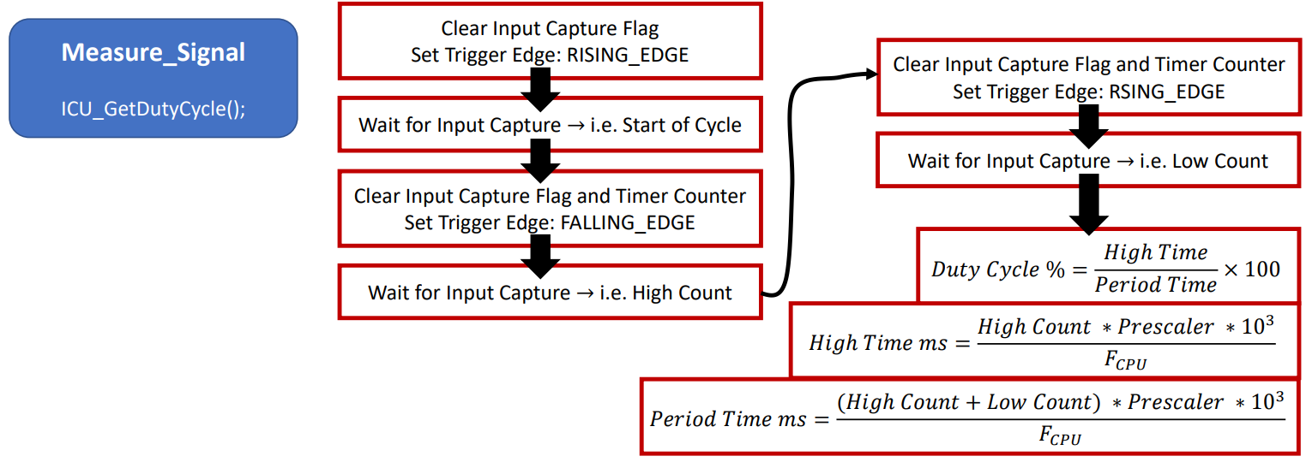

Slide 9
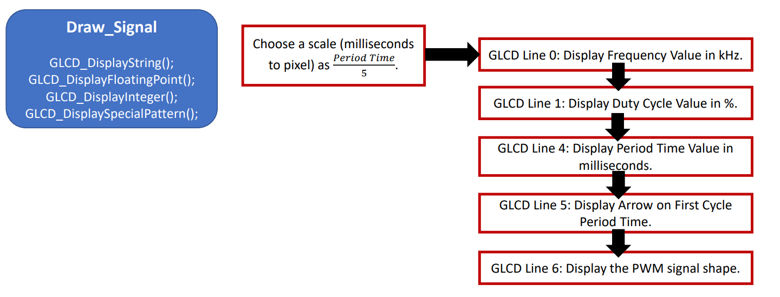

Slide 10
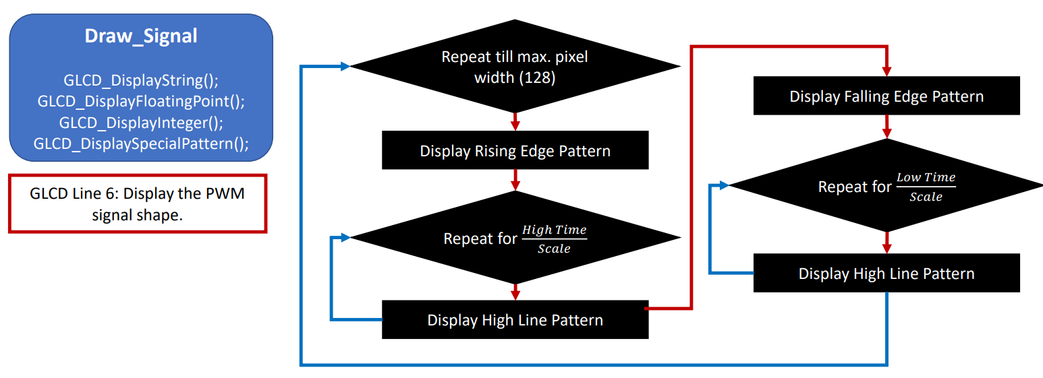

Slide 11
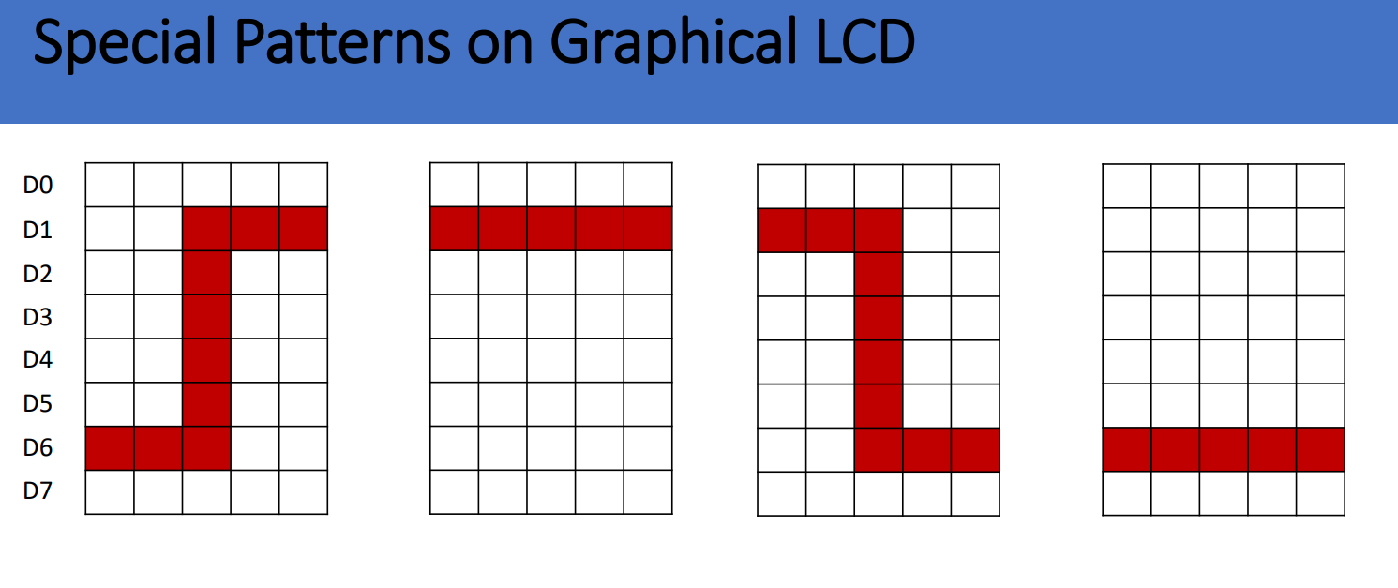
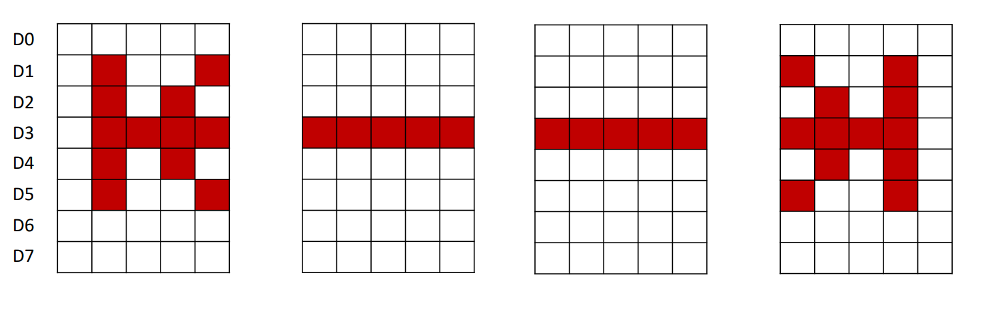

Slide 12

Thank You

